Slide 2
Lunch & Learn (22nd April 2020) COVID-19 Leases | Finance | Strategy
Ben Harnwell (Manningham Council)
Pam Ashton (Roy A. McDonald CPA | Lindale Insurances)
Andre Ong (Sharrock Pitman Lawyers)
Taylor Tran (Innovation Melbourne)

Slide 3
Disclaimer
The information contained in the webinar presentation and related materials are not intended to constitute specific advice of any kind or the rendering of consulting, or other professional services. The contents of the information provided in the webinar is for general information and use only. All the information is provided in good faith as at the time of the call and is subject to change at any time and without notice.
Under no circumstance shall we have any liability to anyone for any loss or damage of any kind. Accordingly, before taking any actions based on the information, we highly recommend and encourage you to consult with the appropriate professionals specific to your needs and requirements.

Slide 4
Ben Harnwell
Manningham Council
ben.harnwell@manningham.vic.gov.au
(03) 9840 9338
Pam Ashton
Roy A. McDonald CPA
pam@royamcdonald.com
(03) 9848 5933
Andre Ong
Sharrock Pitman Lawyers
andre@sharrockpitman.com.au
(03) 9560 2922
Taylor Tran
Innovation Melbourne
taylor@innovationmelbourne.com.au
0434 568 112

Slide 5
Agenda
Check-in
A few ways to think strategically
Updates
Next steps
Q&A

Slide 6
Checklist
Update Your Financial Records
Prepare a Cash Flow Budget
Apply for Government Stimulus Incentives - Federal Government Cash Boost of between $20k and $100k for eligible businesses
Apply for State Government Subsidies & Grants - state by state it varies but for example, Victoria and NSW are offering $10k payments for eligible businesses.
Job Keeper Entitlements - with updated payroll records we can assess any entitlements.
Understand the Loan Concessions provided by the banks
Tax Office Deferral Options
Marketing Plan – every business needs a new marketing plan

Slide 7
Strategy
Recession Proofing & Rescuing Your Business
Budgeting & Cashflow Forecasting
Scenario planning
Pricing
Potential cash shortages
Likely cash position
Plan tax payments
Seasonal peaks & troughs
Staffing considerations
Tax Planning
Profit maximization
Risk Analysis

Slide 8
What is available
Cashflow boost for employers
JobKeeper payment
Supporting employers with apprentices & trainees
Temporary relief for financially distressed businesses
Increasing the instant asset write off
SME Guarantee Scheme
Business Support Fund
Individuals & Households
JobSeeker
Superannuation

Slide 9
Sharrock Pitman Legal: Update on Commercial Leases
Covid 19 Principles
National Cabinet Mandatory Code of Conduct (effective from 3 April 2020)
Eligibility – Based on Jobkeeper and $50 million turnover cap
The Code:
1. Landlords must not terminate leases due to non-payment of rent during the COVID-19 pandemic period (or reasonable subsequent recovery period).
2. Tenants must remain committed to the terms of their lease, subject to any amendments to their rental agreement negotiated under this Code. Material failure to abide by substantive terms of their lease will forfeit any protections provided to the tenant under this Code.
3. Landlords must offer tenants proportionate reductions in rent payable in the form of waivers and deferrals (a waiver being the Landlord granting a whole or partial rent free component and a deferral being the Landlord deferring payment or all or part of the rent to a later date in line with the Code) of up to 100% of the amount ordinarily payable, on a case-by-case basis, based on the reduction in the tenant’s trade during the COVID-19 pandemic period and a subsequent reasonable recovery period.
4. Rental waivers must constitute no less than 50% of the total reduction in rent payable under principle #3 above over the COVID-19 pandemic period and should constitute a greater proportion of the total reduction in rent payable in cases where failure to do so would compromise the tenant’s capacity to fulfil their ongoing obligations under the lease agreement. Regard must also be had to the Landlord’s financial ability to provide such additional waivers. Tenants may waive the requirement for a 50% minimum waiver by agreement.
5. Payment of rental deferrals by the tenant must be amortised over the balance of the lease term and for a period of no less than 24 months, whichever is the greater, unless otherwise agreed by the parties.

Slide 10
The Code - Continued
6. Any reduction in statutory charges (e.g. land tax, council rates) or insurance will be passed on to the tenant in the appropriate proportion applicable under the terms of the lease.
7. A landlord should seek to share any benefit it receives due to deferral of loan payments, provided by a financial institution as part of the Australian Banking Association’s COVID-19 response, or any other case-by-case deferral of loan repayments offered to other Landlords, with the tenant in a proportionate manner.
8. Landlords should where appropriate seek to waive recovery of any other expense (or outgoing payable) by a tenant, under lease terms, during the period the tenant is not able to trade. Landlords reserve the right to reduce services as required in such circumstances.
9. If negotiated arrangements under this Code necessitate repayment, this should occur over an extended period in order to avoid placing an undue financial burden on the tenant. No repayment should commence until the earlier of the COVID-19 pandemic ending (as defined by the Australian Government) or the existing lease expiring, and taking into account a reasonable subsequent recovery period.
10. No fees, interest or other charges should be applied with respect to rent waived in principles #3 and #4 above and no fees, charges nor punitive interest may be charged on deferrals in principles #3, #4 and #5 above.
11. Landlords must not draw on a tenant’s security for the non-payment of rent (be this a cash bond, bank guarantee or personal guarantee) during the period of the COVID-19 pandemic and/or a reasonable subsequent recovery period.
12. The tenant should be provided with an opportunity to extend its lease for an equivalent period of the rent waiver and/or deferral period outlined in item #2 above. This is intended to provide the tenant additional time to trade, on existing lease terms, during the recovery period after the COVID-19 pandemic concludes.
13. Landlords agree to a freeze on rent increases (except for retail leases based on turnover rent) for the duration of the COVID-19 pandemic and a reasonable subsequent recovery period, notwithstanding any arrangements between the landlord and the tenant.
14. Landlords may not apply any prohibition on levy any penalties if tenants reduce opening hours or cease to trade due to the COVID-19 pandemic.
Separate to the Code note Victorian Governments Commercial Tenancy Relief – 25% Discount on Land Tax and Deferral of balance until March 2021

Slide 11
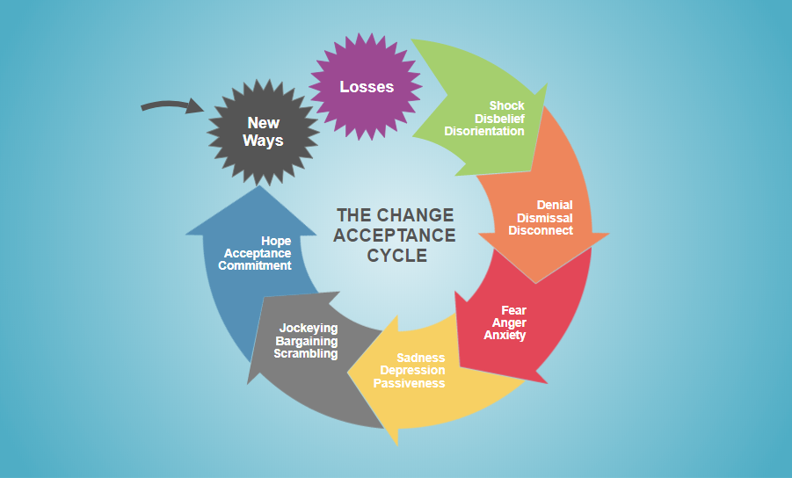
Check in
Source: www.smartdraw.com

Slide 12
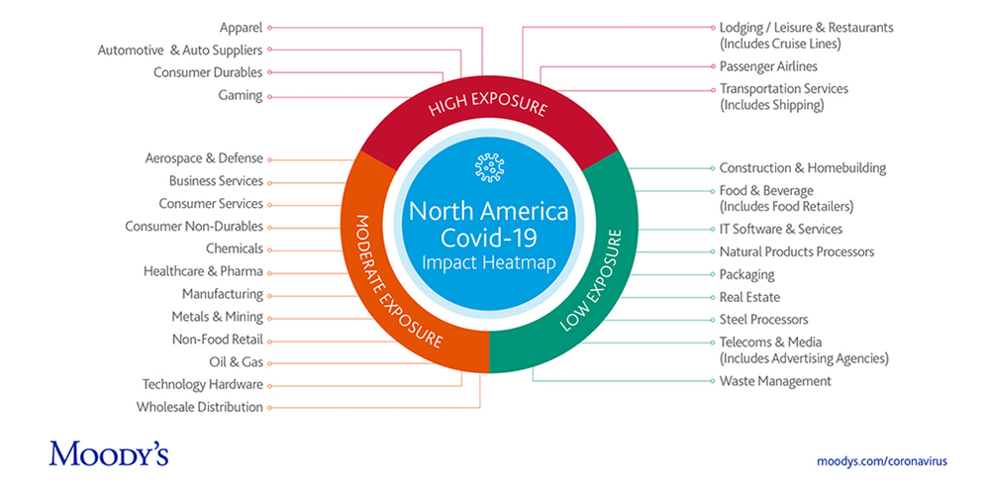
COVID-19 Industry Impact Heatmap

Slide 13
Key questions you might have
Immediate things you need to do? – group into controllable versus uncontrollable, important not important, urgent and not urgent
Who can help and here to go?
What are the skills and capabilities you need to develop?
Will your core customers still be there? 6, 12, 24 months?
Competitors and relative offerings?
Prospects of the industry and trends?
Plausible scenarios for the future?
What are the risks?
Your current assets, capabilities and energy
Don’t forget personal wellbeing
Decide on your next pivot or get prepared

Slide 14
Ben Harnwell
Manningham Council
ben.harnwell@manningham.vic.gov.au
(03) 9840 9338
Pam Ashton
Roy A. McDonald CPA
pam@royamcdonald.com
(03) 9848 5933
Andre Ong
Sharrock Pitman Lawyers
andre@sharrockpitman.com.au
(03) 9560 2922
Taylor Tran
Innovation Melbourne
taylor@innovationmelbourne.com.au
0434 568 112

